Slide 1
EXCEL

Slide 2
Q1
INFERENCE
STEPS
Formula

Slide 3
Q3
INFERENCE
Row Labels | Average of views | Sum of likes
Autos & Vehicles | 1500201 | 54702
Education | 1198848 | 92950
Entertainment | 862396.8 | 53599
Film & Animation | 847732.7 | 2516
Howto & Style | 488661.3 | 12238
Music | 469426.5 | 701192
News & Politics | 435653.5 | 136839
People & Blogs | 357043.5 | 27650
Religious | 235321 | 45128
Science & Technology | 60538.93 | 49603
Sports | 40741.77 | 21857
STEPS
Formula

Slide 4
Q3
INFERENCE
STEPS
Formula

Slide 5
Q4
INFERENCE
STEPS
Formula

Slide 6
Q5
INFERENCE
CONCAT(C2,D2)
STEPS
Formula

Slide 7
Q6
INFERENCE
Row Labels | Count of comments_disabled
FALSE | 15715
TRUE | 592
STEPS
Formula

Slide 8
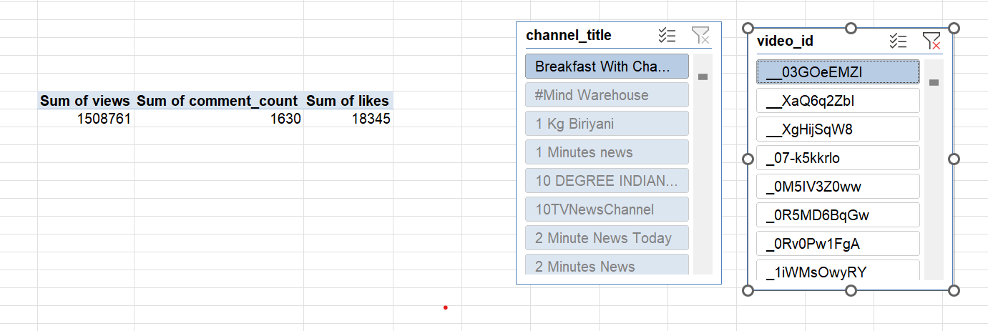
Q7
INFERENCE
STEPS
Formula

Slide 9
Q8
INFERENCE
 | Row Labels | Sum of views | Sum of likes | Sum of engagement
 | Autos & Vehicles | 11331023 | 189163 | 216108
 | Comedy | 798799040 | 38804398 | 41921871
 | Education | 73816757 | 3529171 | 3985136
 | Entertainment | 4337761090 | 83836195 | 92805828
 | Film & Animation | 941674037 | 14308758 | 15504848
 | Gaming | 68728039 | 1988458 | 2167038
 | Howto & Style | 395218494 | 4322796 | 4734619
 | Movies | 7724380 | 80026 | 84643
 | Music | 2447689197 | 54100112 | 57550717
 | News & Politics | 744883343 | 5762909 | 6819339
 | People & Blogs | 554921583 | 8841134 | 9873597
 | Pets & Animals | 2490776 | 186307 | 207691
 | Religious | 3929208 | 127654 | 134668
 | Science & Technology | 199386704 | 9566636 | 12948618
 | Shows | 78556290 | 427347 | 491453
 | Sports | 478635632 | 9389714 | 10176041
 | Travel & Events | 771631 | 13048 | 15284
STEPS
Formula

Slide 10
Q9
INFERENCE
STEPS
Formula

Slide 11
Q10
INFERENCE
Likes from 20% hiked to 80% in 2018.
Views from 19% to 81% in 2018
 | Years (publish_date) | Sum of views | Sum of likes
 | 2017 | 39299817 | 240677
 | 2018 | 169746270 | 977090
 | Grand Total | 209046087 | 1217767
STEPS
Formula

Slide 12
Q11
INFERENCE
STEPS
Formula

Slide 13
Q12
INFERENCE
STEPS
Formula

Slide 14
Q13
INFERENCE
Comment count is high in entertainment category
Row Labels | Sum of comment_count
Entertainment | 8969633
Music | 3450605
Science & Technology | 3381982
Comedy | 3117473
Film & Animation | 1196090
News & Politics | 1056430
People & Blogs | 1032463
Sports | 786327
Education | 455965
Howto & Style | 411823
Gaming | 178580
Shows | 64106
Autos & Vehicles | 26945
Pets & Animals | 21384
Religious | 7014
Movies | 4617
Travel & Events | 2236
STEPS
Category for row
And
Comment count for value column

Slide 15
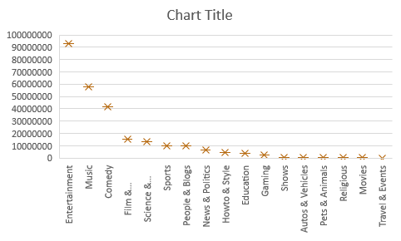
Q14
INFERENCE
High engagement in enterntainment videos,
Less engagement in travel and events
Row Labels | Sum of engagement
Entertainment | 92805828
Music | 57550717
Comedy | 41921871
Film & Animation | 15504848
Science & Technology | 12948618
Sports | 10176041
People & Blogs | 9873597
News & Politics | 6819339
Howto & Style | 4734619
Education | 3985136
Gaming | 2167038
Shows | 491453
Autos & Vehicles | 216108
Pets & Animals | 207691
Religious | 134668
Movies | 84643
Travel & Events | 15284
STEPS
Category as row and engagement(likes+comments )as engagement taken as value.
Box plot for visualization
Formula

Slide 16
Q15
INFERENCE
Likes has highest correlation values
And dislikes has min
likes | 99.59%
comment | 82%
dislikes | 55%
STEPS
Filter videoed based on likes ,dislikes and comment count
Formula to calculate correlation values for variables
Formula
=CORREL(E:E,B:B)

Slide 17
Q16
INFERENCE
STEPS
Formula

Slide 18
Q17
INFERENCE
STEPS
Formula

Slide 19
Q18
INFERENCE
STEPS
Formula

Slide 20
Q19
INFERENCE
STEPS
Formula

Slide 21
Q20
INFERENCE
STEPS
Formula

